Slide 1
Alun Francis OBE
Interim Chair of the Social Mobility Commission

Slide 2


Background
Notes:
A year ago, the government published the Inclusive Britain policy paper.
Inclusive Britain set out the government’s actions in response to the recommendations made by the Commission on Race and Ethnic Disparities (CRED).
One of their actions focused on enhancing social mobility through education choices, which overlapped with a lot of our areas of interest.
We therefore committed to take forward this action, and look at investigating and improving the information available to young people about the labour market value of qualifications, hoping to improve their employment prospects.

Slide 3
Background
Good information on the labour market value of different qualifications is essential.
Many students enrol at least partly in order to acquire skills and qualifications for a career.
Studying can incur a significant financial burden.
Crucial that students are equipped to make informed decisions.
Benefits all, but particularly the most disadvantaged.
Notes:
Good information on the labour market value of different qualifications is essential.
This is important for a number of reasons:
Many students enrol on a course at least partly in order to to make themselves more employable and gain access to their chosen career
Many courses, particularly in HE, come with a significant cost
There are a huge amount of FE and HE qualifications available and more people than ever are going on to FE or HE
Of course there are many reasons why someone might choose a course, that aren’t related to how much they might earn!
BUT, we need them to be able to make informed decisions
Better information benefits everyone, but it’s particularly important to us, as good labour market outcomes have the potential to catapult people into higher earnings, improving social mobility
Students from lower socio-economic backgrounds are less likely to have other sources of information to draw on, so it’s essential that this is available to them

Slide 4
Our actions
Summary report
Review of current evidence on labour market outcomes of qualifications in HE and FE
Identification of key gaps in the literature
Exploratory analysis comparing value-add of HE institutions and their performance against selected access metrics
Review of currently available information about labour market outcomes
Surveys
Whether students accessed information on labour market outcomes
Who influenced their choice of qualification
Notes:
In the last year, we’ve taken forward this action in a number of ways:
Report looking at evidence on the labour market value of different HE and FE qualifications and any links to access for students from lower socio economic backgrounds
A review of what information is available to students, and how this is presented
Research into what information students are actually accessing, and what factors influence their decisions about what and where to study

Slide 5

Summary report
Focused on value-add, not just raw earnings.
Value-add accounts for individual characteristics.
Not a full review of all available literature on this subject - a first step.
Used studies based on LEO data - administrative data is less prone to selection bias than survey-based studies.
Lots of factors can’t be easily measured - e.g. interests, job and life satisfaction.
Notes:
First, we published our initial report on 9th February 2023.
We looked specifically at earnings by qualification type, subject and institution type.
The research suggests that, on average, studying a qualification in either HE or FE is associated with increased future earnings.
The majority of courses also provide positive ‘value-add’ - the difference in future earnings which can be associated with the qualification, rather than other personal factors such as someone’s prior attainment.
Focusing on value-add is particularly important - students at a university which accepts pupils with high prior academic attainment may earn more than those from a university with lower entry requirements. However, students with high prior academic attainment may also be likely to go on to have high earnings even without studying at that university, so we need to take this into account. Otherwise we risk attributing high earnings to a university or course, even if it did not provide any additional boost in earnings potential.

Slide 6
Higher Education
Key findings
Notes:
Most HE courses offer positive value-add, improving the earning potential of graduates.
This can be a really important tool for social mobility, as the gap in earnings between the most and least advantaged state schooled pupils halves between those who went to university.
For those who went to a highly selective university, the gap almost disappears.
Graduating from a more selective university seems to be a great way for students from lower socio-economic backgrounds to overcome initial disadvantage and catch up to their wealthier peers.
There are also a few courses with negative value-add, suggesting students would have been better off financially doing another course.

Slide 7
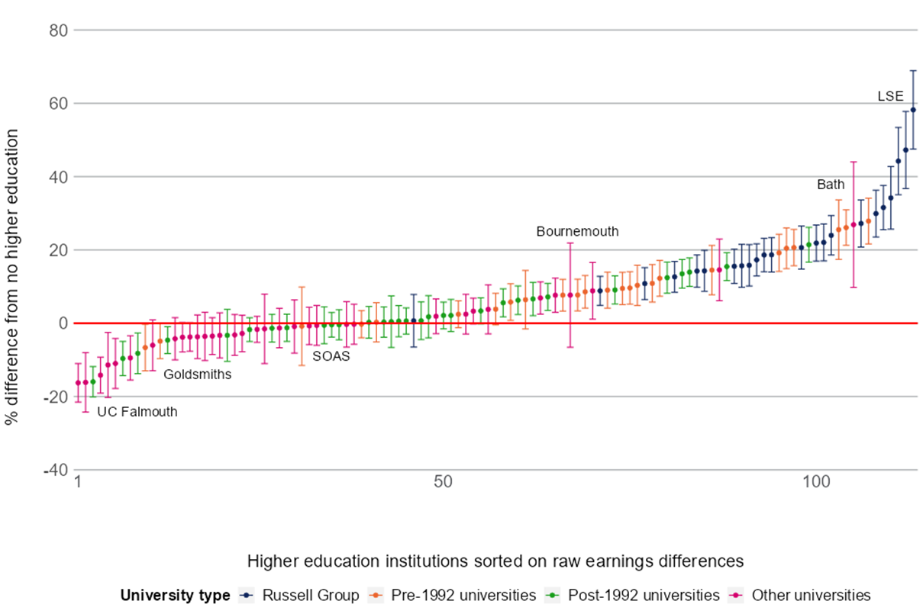
Variation in value-add between HE institutions
● Russell Group unis tend to have the highest value-add
● Then Pre-1992 unis
● Post-1992 and ‘Other’ unis tend to have lower value-add
Notes:
However, there is a lot of variation in value-add by institution, with more selective universities generally providing higher value-add
Chart shows the percentage value-add in earnings for men aged 29, by institution attended and university type. This is based on 2002 to 2007 GCSE cohorts, conditional on being in sustained employment, and controlling for age, background and prior attainment.
Value-add in earnings at the age of 29 ranges from:
For men: -16% at Falmouth university to 58% at LSE
This graph shows the data for men, but it is broadly similar for women, with value add ranging from -11% at Bolton university to 94% at LSE

Slide 8
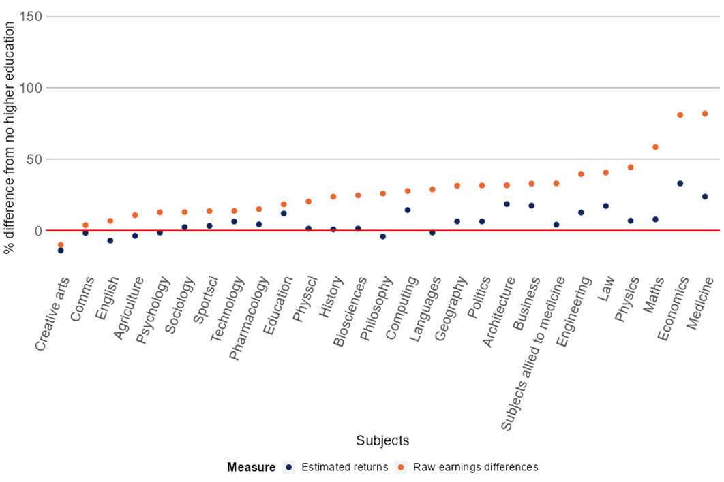
Variation in value-add between HE subjects
STEM (science, technology, engineering and mathematics) and LEM (law, economics and management) subjects generally have higher value-add
Notes:
Similarly, there is a lot of variation in value-add by subject.
STEM (science, technology, engineering and mathematics) and LEM (law, economics and management) subjects generally have a higher value-add
For men: Economics has the highest value-add with 33% higher earnings
For women: Medicine has the highest value-add with 75% higher earnings
The chart shows earnings differences and estimated returns at age 29 for men by subject, compared to similar individuals who did not attend HE.

Slide 9
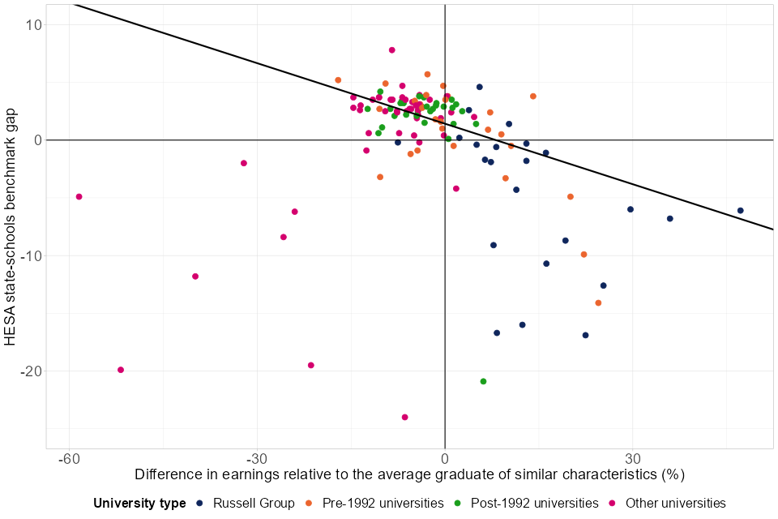
The problem for social mobility
Notes:
Chart shows analysis done by the SMC showing the relationship between the HESA benchmark and value-add in earnings by university type for men. (NB chart is for men, but chart for women is broadly the same)
Most universities which offer high value-add are underperforming against their benchmarks - this means they tend to have fewer students from state schools or low-participation neighbourhoods.
At the least selective universities, where value-add was lower, 20 to 30% of students were FSM eligible at age 16. This falls to below 2% in the 10 most selective, where value-add is higher.
If going to university may increase social mobility in terms of earnings, but disadvantaged students are less likely to be able to access universities with higher value-add, this may have social mobility implications.
Many of the more selective universities would seem to be hindering social mobility, because students from lower SEB with the required grades are under-represented on their high value-add courses.
We need these universities to do more to improve access.
Also, many courses at less selective universities seem to add little in terms of labour market value, and students from lower SEBs are over-represented here.
We need to ensure prospective students are aware of the likely boost to earnings, so they can make an informed choice, before applying.

Slide 10
Further Education
Key findings
Notes:
FE qualifications were also associated with an increased income
This was true at each higher level of FE qualification.
However, the fragmented nature of the FE system makes value harder to understand and compared to HE, there is less research published and data available.
There are large-scale graduate surveys looking at the careers and salaries of recent HE graduates, which provide robust data on their average earning outcomes.
The same does not exist in FE, limiting the data we have available.

Slide 11
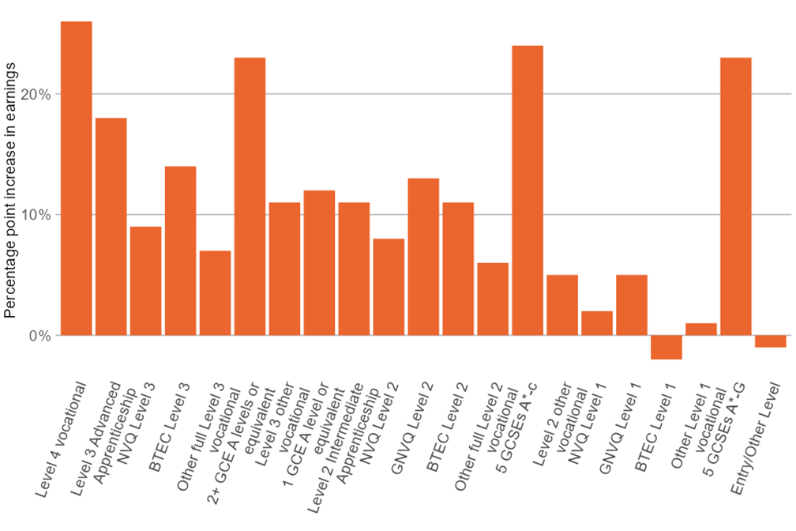
Increased earnings compared to a similar learner with a qualification at the previous level
Working your way up the qualification ladder may lead to higher future earnings
Notes:
Chart shows increased earning (%) by level of qualification.

Slide 12
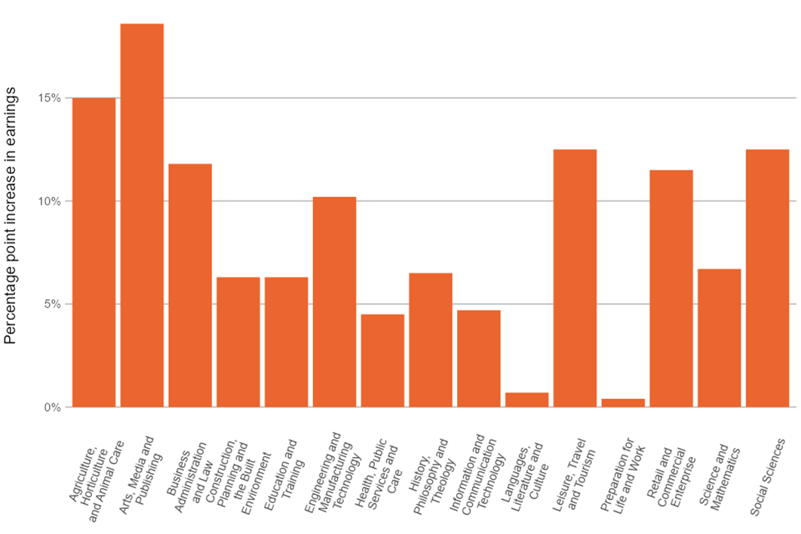
Variation in value-add between subject areas
Engineering top for men
Business administration and law top for women
We do not know whether people who studied in these sectors went on to work in them
Notes:
Chart shows earnings for field of study 5 years after studying in FE for women.
Percentage difference in earnings for the field study relative to the average person of similar characteristics who did not study a subject in that field.

Slide 13






Availability of information
Notes:
Lots of HE and FE information sources.
Some designed to be accessed by young people themselves, and those that support them.
Many include information on the labour market value of qualifications.
However information is disparate and not accessible in a centralised format.
Where the data exists it is often not presented in a way that is useful to young people
OfS data dashboard and DfE Further education outcomes dashboard contain useful information, but aren’t designed to be accessed by young people
Similarly there is academic research into labour market outcomes but it’s unlikely this is widely used by students!
UCAS and Discover Uni provide some user-friendly average earnings information, but this is almost all for HE.

Slide 14
Surveys
Survey 1: upReach students
Current HE students
Sample size of 476
Students from lower-income households who attended UK state schools
Higher than average A-Level grades
Highly engaged with their education and future career options
Survey 2: Wider target
Current sixth form students
Current HE and FE students
HE and FE alumni
Sample size of 1,487
86% of respondents were current sixth form students
Notes:
Conducted 2 surveys to find out what information students access, and what they care about
upReach students, having chosen to be part of a programme aimed at increasing their employability, are potentially more likely to have undertaken research into their future career prospects when deciding on their university choice, and are not necessarily representative of students as a whole.
While our second survey was open to prospective and current students/learners, as well as alumni, the vast majority of responses were from sixth formers, so that’s what we’ve focused on in the next slides
While responses from HE and FE students and alumni were limited in number, the results from these respondents were consistent with our general findings.

Slide 15
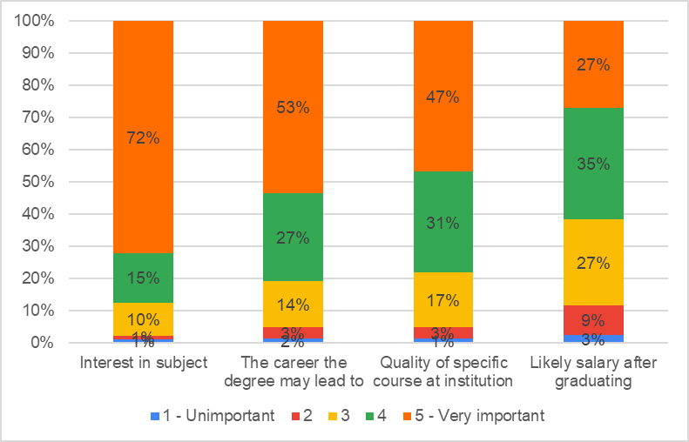
Respondents prioritise their interest when considering study
Top concerns are:
Interest in the subject
The career the qualification may lead to
The quality of specific course and institution are the most important factors when deciding where and what to study.
Likely salary after graduating - 4th most important
Notes:
Potential salary is not the top concern of most students, but it is important, coming fourth in both surveys
After interest in subject, career the qualification may lead to and the quality of the specific course

Slide 16
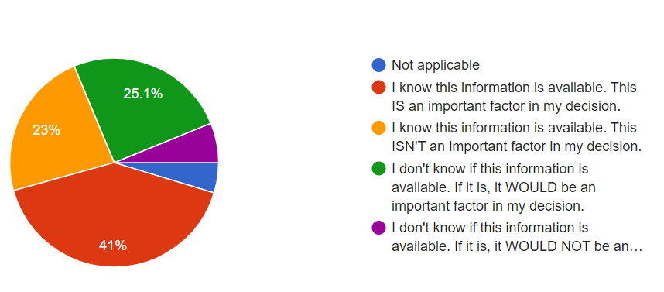
Many sixth form students don’t know that salary information is available
Notes:
Many students don’t know that typical salary information is available.
1 in 4 considering a degree didn’t know they could get that information, but it would be an important factor in their decision about what and where to study
This increases to 1 in 3 for students considering vocational qualifications
Really problematic that between a quarter and a third of students are unable to access information that would influence their decision, particularly when this has the potential to significantly impact their future earnings.

Slide 17
4. The most popular source of information about salaries is from institutions' websites
 | Considering a degree | Considering a VTQ
University/college own website | 44% | 32%
Careers advice websites e.g. UCAS, Prospects | 32% | 17%
National Careers Service or other government sources | 17% | 15%
Universities guides such e.g. The Times, The Guardian | 14% | N/A
Industry regulators or websites | 10% | 7%
School/college careers service | 10% | 15%
Notes:
For those who did access information on typical future salaries, most were looking at that on institutions’ own websites, with many also checking well-known online sources such as UCAS and Prospects which provides job information to students.
Interesting that very few were finding out about earning potential from their school or college careers service.

Slide 18
What can we do?
A central, impartial hub of information.
Better data on the value of FE qualifications.
Additional surveys, focusing on students from lower socio-economic backgrounds.
Improved access benchmarks for universities.
Notes:
Clear from our work so far that action needs to be taken to make sure prospective students have access to high-quality information on the labour market value of different qualifications
Particularly important for students from lower SEB.
They are less likely to attend courses with a high value-add, and therefore likely to earn less after graduating.
Also less likely to have networks who can help them navigate their choices.
Want to discuss these questions with our panel, and hear ideas for you - you’re all experts in this field, and we want to work together to think about the best ways to help young people make good choices.

Slide 19
Thank you for joining us We welcome questions and feedback
contact@socialmobilitycommission.gov.uk
020 7340 8397
@SMCommission
social-mobility-commission
@socialmobilitystories
socialmobilityworks.org
gov.uk/government/organisations/social-mobility-commission
Social Mobility Commission
Sanctuary Buildings
20 Great Smith Street
London
SW1P 3BT

